Slide 1

Supporting the Design of Experiments for Synthetic Biology with Clotho 3.0
Nicholas Roehner
CIDAR (Densmore Lab)
Boston University

Slide 2
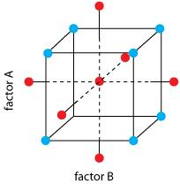
Design of Experiments (DOE)

Slide 3
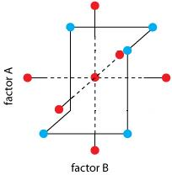
Design of Experiments (DOE)

Slide 4





Clotho 3.0
Schemas
Converters
Scripts
Database

Slide 5





DOE for Synthetic Biology
Biological
Design
Design of Experiments
Experimental
Data

Slide 6
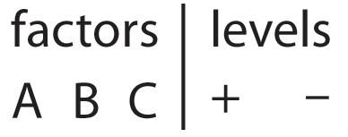
Object-Oriented DOE
Biological
Design
Experimental
Data

Slide 7
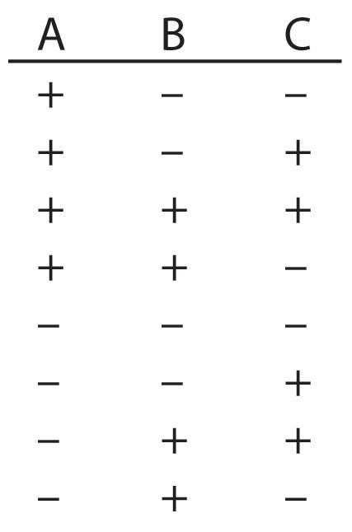
Object-Oriented DOE
Biological
Design
Experimental
Data

Slide 8
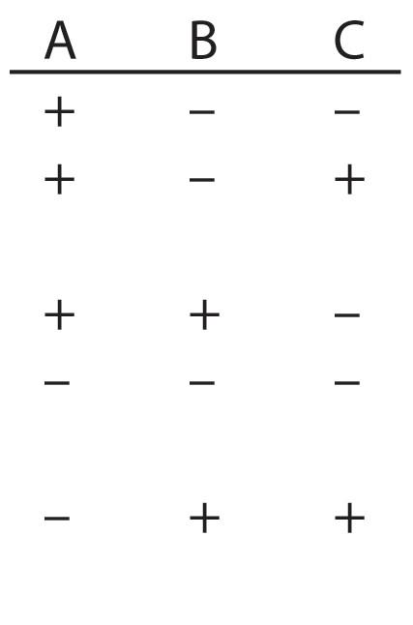
Object-Oriented DOE
Biological
Design
Experimental
Data

Slide 9



Object-Oriented Biodesign
Experimental
Data

Slide 10







Object-Oriented Biodesign
Experimental
Data

Slide 11
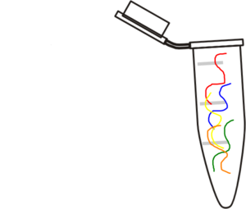
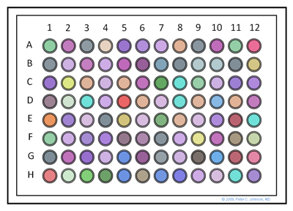
Object-Oriented Experiments

Slide 12
Talk Outline
Overview of Clotho 3.0 object classes and planned extensions for biodesign and DOE
Development plan for web app to support DOE for synthetic biology

Slide 13
Clotho 3.0 Object Classes
Part
Format
Sequence

Slide 14




Clotho 3.0 Object Classes
Part
Format
Sequence
ATTCA
ATCGA
GGCTA
ATTCA

Slide 15


Clotho 3.0 Object Classes
Part
Sequence
GCTAA
ATCGA
GGCTA
ATTCA

Slide 16
Clotho 3.0 Object Classes
ATCGAGGCTAATTCAGCTAA
Part
Sequence
GCTAA
ATCGA
GGCTA
ATTCA

Slide 17
Clotho 3.0 Object Classes
Sequence
ATCGAGGCTAATTCAGCTAA
Annotation
Feature
GCTAA
ATCGA
GGCTA
ATTCA

Slide 18





Clotho 3.0 Object Classes
ATCGAGGCTAATTCAGCTAA
Sequence
Annotation
Feature
GCTAA
ATCGA
GGCTA
ATTCA

Slide 19
Principles for extending Clotho 3.0
New object classes should
Model new domains of data and relate them to domains previously captured by Clotho
Represent data at an appropriate level of detail
Provide generally useful functions for computing over stored data

Slide 20
Modeling New Domains of Data
Data

Slide 21
Modeling New Domains of Data
Biodesign
Experimental

Slide 22
Modeling New Domains of Data
Function
Context
Structure
Experimental

Slide 23
Modeling New Domains of Data
Function
Context
Sequence, Part,
Format
Experimental

Slide 24
Modeling New Domains of Data
Module, Feature, Influence, Parameter
Context
Sequence, Part,
Format
Experimental

Slide 25
Modeling New Domains of Data
Module, Feature, Influence, Parameter
Strain, Medium
Sequence, Part,
Format
Experimental

Slide 26
Modeling New Domains of Data
Module, Feature, Influence, Parameter
Strain, Medium
Sequence, Part, Format
Physical
ExperimentalDesign

Slide 27
Modeling New Domains of Data
Module, Feature, Influence, Parameter
Strain, Medium
Sequence, Part, Format
Physical
Factor,
Level,
Variable,
Data

Slide 28
Modeling New Domains of Data
Module, Feature, Influence, Parameter
Strain, Medium
Sequence, Part, Format
Sample, Container, Plate,
Device
Factor,
Level,
Variable,
Data

Slide 29
Biodesign
Strain
Biodesign
Module
Medium
Part
Parameter

Slide 30


Biodesign
Parameter
Biodesign
Module
Biodesign

Slide 31
Biodesign
5
Biodesign
Module
Biodesign
67

Slide 32
Module
Module
Influence
Feature

Slide 33
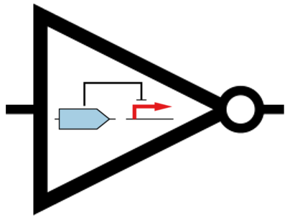
Module

Slide 34
Parameter
Parameter
Derivation
Experimental Data

Slide 35
Parameter
Constant
Derivation
Derivation
Random Variable
Experimental Data

Slide 36
Parameter
Derivation
Random Variable
Histogram

Slide 37
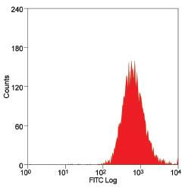
Parameter
Derivation
921 ± 102

Slide 38
Experiment
Experiment
Response Variable
Sample
Experimental Unit
Experimental Data

Slide 39
Sample and Device
Biodesign
Plate
Device
Sample
Container
Experimental Data

Slide 40
Experiment
Experiment
Response Variable
Sample
Experimental Unit
Experimental Data

Slide 41
Factorial Experiment
Factorial Experiment
Response Variable
Sample
Factorial Unit
Experimental Data

Slide 42
Factorial Experiment
Factorial Experiment
Factorial Unit
Factor
Level

Slide 43
Factorial Experiment
Factorial Experiment
Factorial Unit
Factor
Level

Slide 44
Talk Outline
Overview of Clotho 3.0 object classes and planned extensions for biodesign and DOE
Development plan for web app to support DOE for synthetic biology

Slide 45

Web Application: Code Name Jump Rope
Jump Rope
Jump Rope

Slide 46
Web Application
Jump Rope
Jump Rope

Slide 47
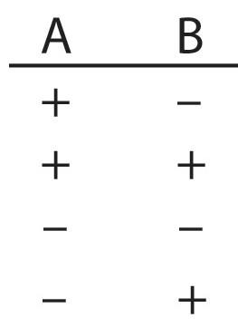
Web Application

Slide 48
Web Application
Jump Rope
Jump Rope

Slide 49
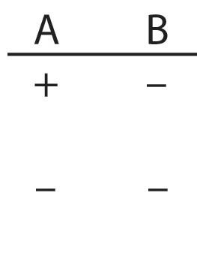
Web Application

Slide 50
Web Application

Slide 51
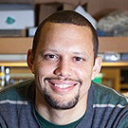


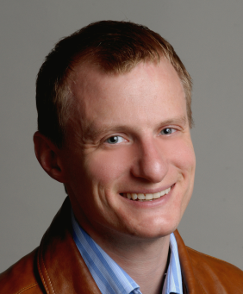


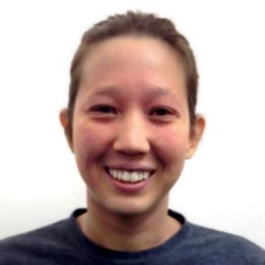

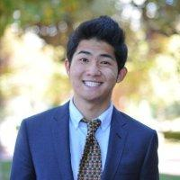
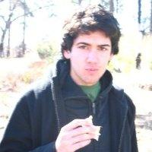



Clotho Team
Douglas
Densmore
J. Christopher
Anderson
Stephanie
Paige
Prashant
Vaidyanathan
Bill
Cao
Maxwell
Bates

